Slide 1
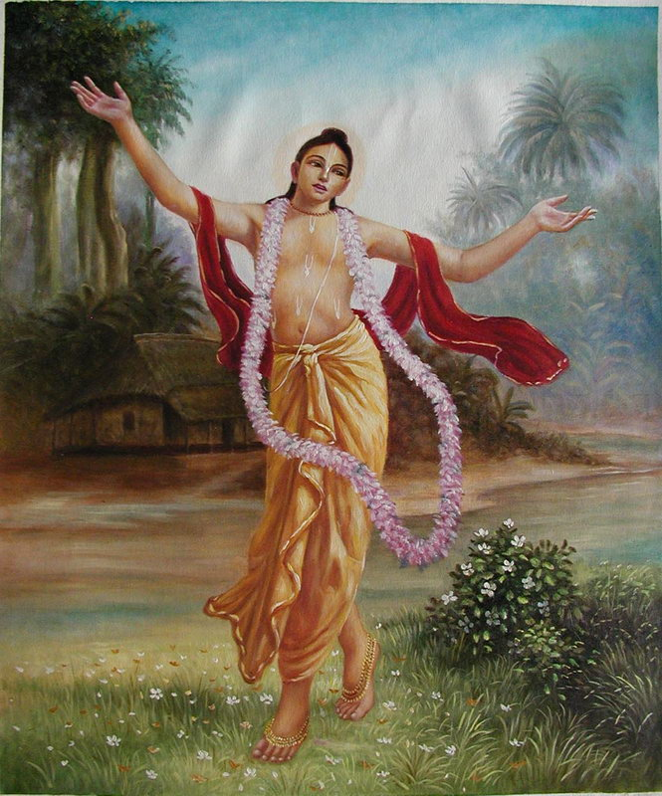
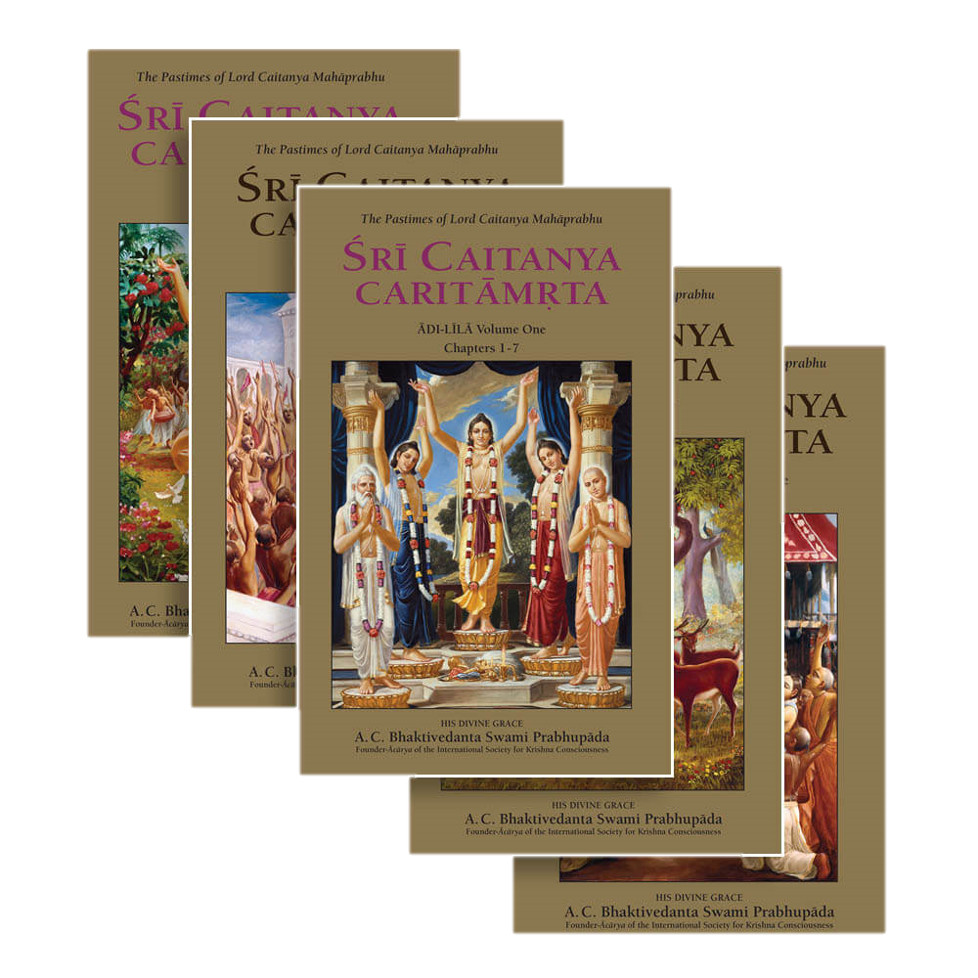
Chaitanya CaritamritA distribution
ICC Book Distribution Committee Presents
“This book selling is the real preaching of our cult. Especially when you sell Chaitanya Critamrit and Bhagavatam.” ~ Srila Prabhupada

Slide 2
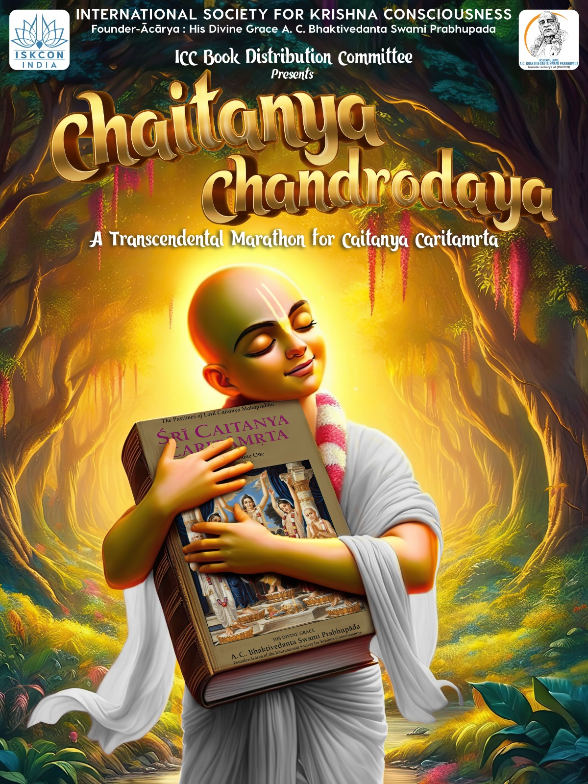
…..I want that every respectable person has a full set of Bhagavatam & Chaitanya Caritamrit in his home.
~ Srila Prabhupada to Drdha-Vrta, Rsabhadeva & Stan
California USA, 24th January 1977

Slide 3
Caitanya Caritamrta Nitya nutana
Sunite sunite judaya hrdaya sravana
Sri Chaitanya Caritamrit is ever increasingly fresh. For one who hears it again and again, the heart and ear become pacified.
~ CC-Antya Lila 3.19.111

Slide 4
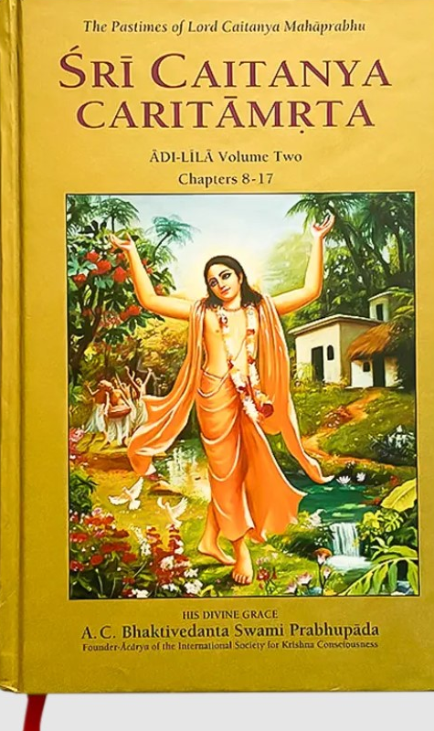
The purpose of this Krishna consciousness movement is stated by Chaitanya Mahaprabhu in the Chaitanya Caritamrit…as you also preach earnestly…you will do the highest good for others and for yourself as well…Gradually spread the book distribution to every home.
~ Srila Prabhupada to Bir Krishna
Mayapur, 10th February, 1977

Slide 5
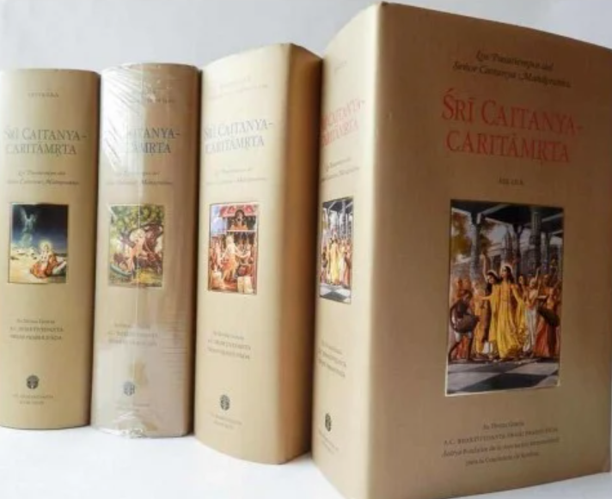
In Chaitanya Caritamrit it is said that nobody should be neglectful of the Siddhanta because by siddhantic conclusion one becomes firm in Krishna consciousness….& the boys and girls in our Krishna society should now give more attention for studying the books very attentively.
~ Srila Prabhupada to Krishna Devi
17th Feb, 1970

Slide 6
siddhanta baliya citte na kara alasa
iha ha-ite krsne lage sudrdha manasa
TRANSLATION
A sincere student should not neglect the discussion of such conclusions, considering them controversial, for such discussions strengthen the mind. Thus one's mind becomes attached to Sri Krsna. Adi 2.117
Notes:
SYNONYMS
siddhanta -- conclusion; baliya -- considering; citte -- in the mind; na kara -- do not be; alasa -- lazy; iha -- this; ha-ite -- from; krsne -- in Lord Krsna; lage -- becomes fixed; su-drdha -- very firm; manasa -- the mind.

Slide 8
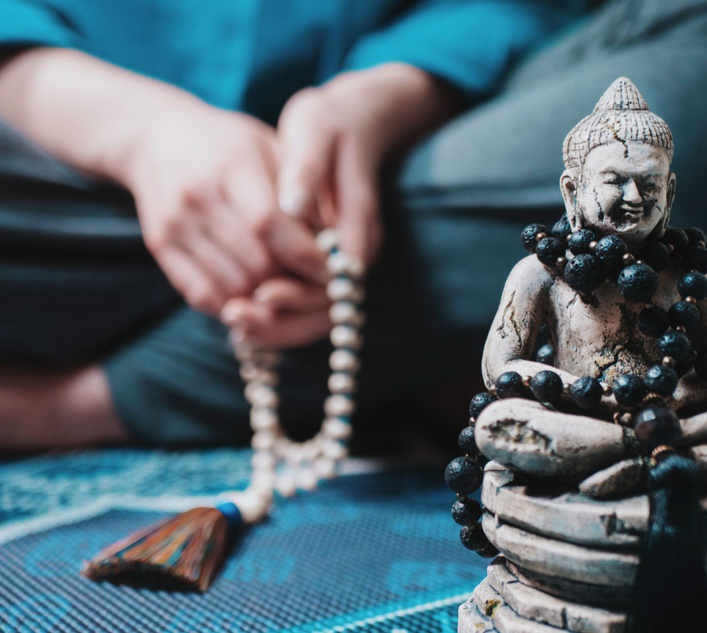
Hare Krishna

